Slide 1


Bank Of Singapore`
(Evanza: A simple yet powerful platform that helps banks streamline events and easily choose the right clients to invite.)

Slide 2
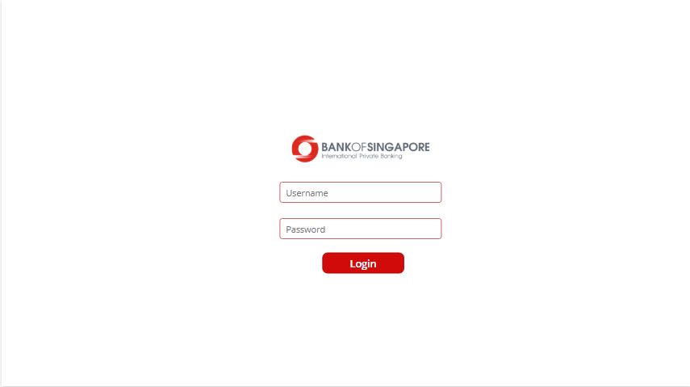
Login Page
Login Page:
Users securely log in with their credentials to access a personalized, role-based dashboard—Banker, Event Manager, or Manager. Robust access controls ensure users cannot access dashboards or data outside their assigned roles.

Slide 3
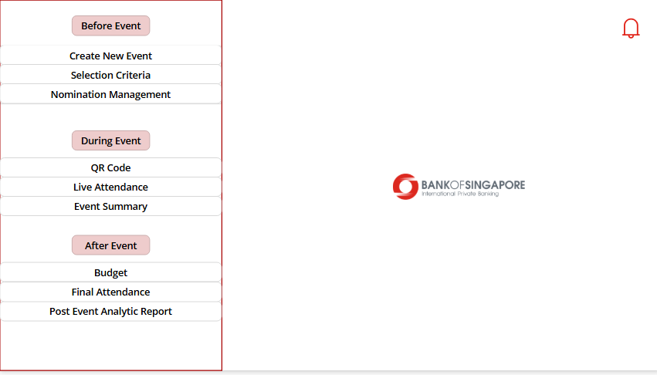
2. Event Manager Screen
Event Manager team:
Defines event details and selection criteria based on strategic goals. A smart QR code-based attendance system ensures efficient participant tracking during the event. Post-event analytics are seamlessly generated and shared with relevant teams to support data-driven decision-making.

Slide 4
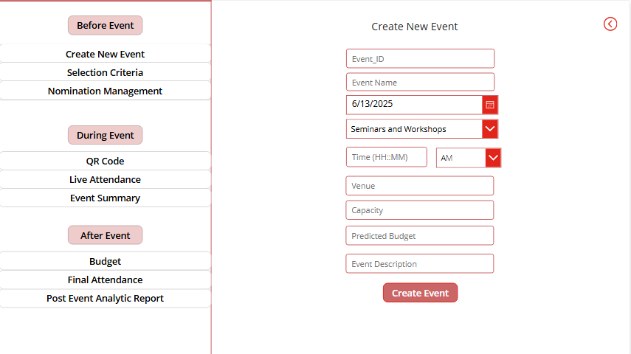
(2.a) Create New Event
Create New Event:
Under the Event Management module, the team can seamlessly create new events by selecting various parameters aligned with event goals. Each event is assigned a unique Event ID, enabling consistent tracking and identification across the Evanza platform.

Slide 5
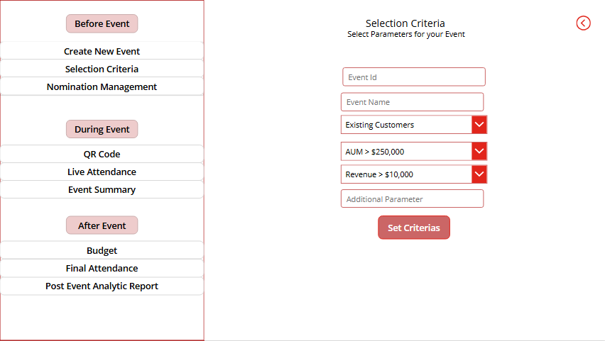
(2.b) Selection Criteria
Selection Criteria:
This module allows the team to define selection criteria for each unique Event ID. Teams can specify the type of clients to be invited—Prospects or Existing—and set financial thresholds such as Assets Under Management (AUM) and Revenue. These filters ensure that the most relevant clients are shortlisted for each event.

Slide 6
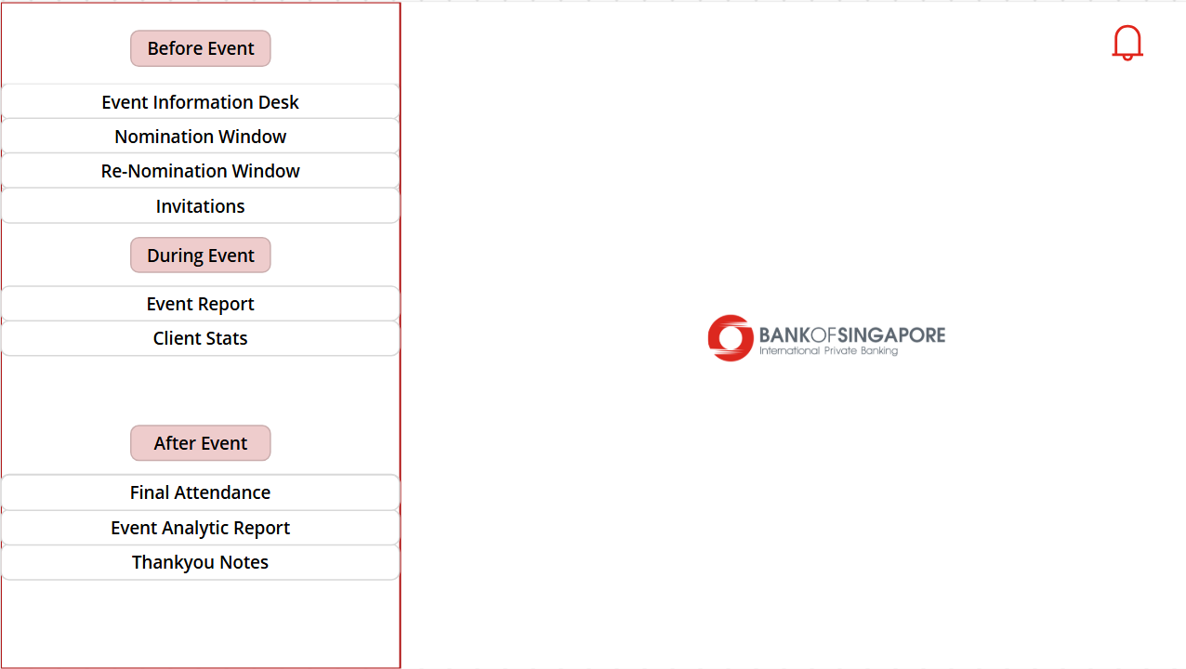
3. Banker’s Screen
Banker Dashboard:
Bankers view client shortlists generated based on selection criteria set by the Event Management team. They can nominate or re-nominate clients—especially if initial invitees decline or become unavailable. The platform also facilitates automatic generation and dispatch of RSVP invitations to selected clients, streamlining the nomination process end-to-end.

Slide 7
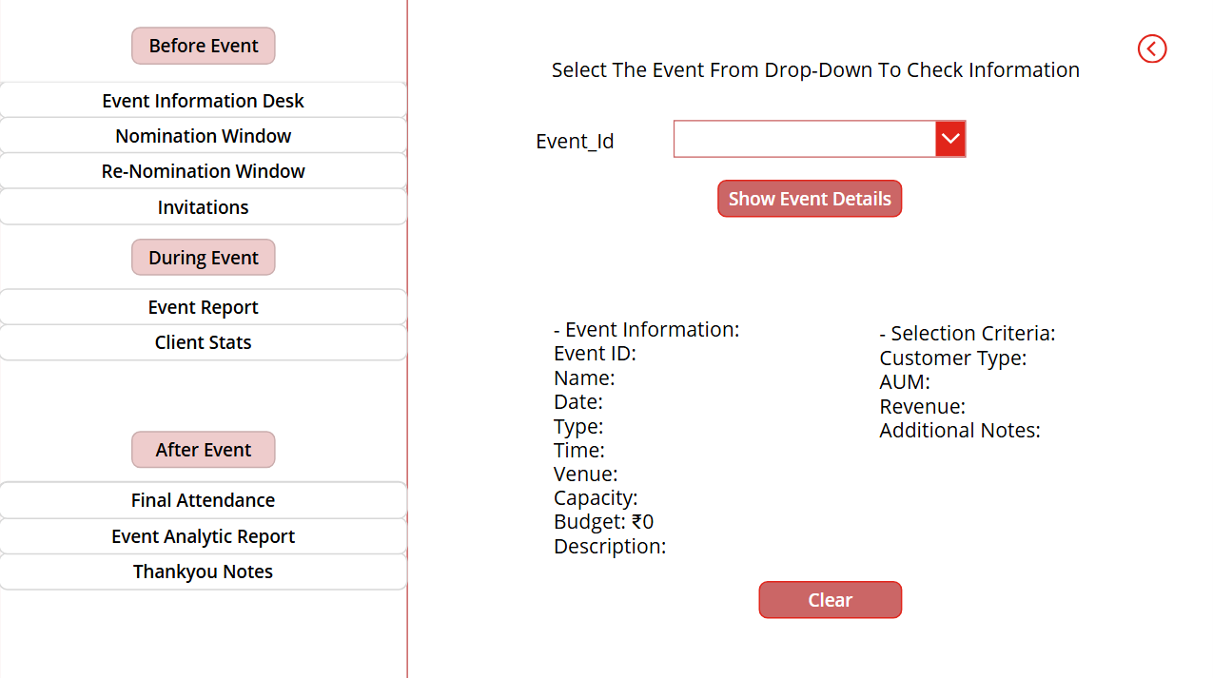
(3.a) Event Information Desk
Event Information Desk:
Located within the Banker Dashboard, this section allows bankers to select a unique Event ID via a dropdown menu. Upon selection, all relevant event details and selection criteria are displayed—including Event Information and parameters. This ensures full transparency and empowers bankers to make informed nomination decisions with no information gaps.

Slide 8
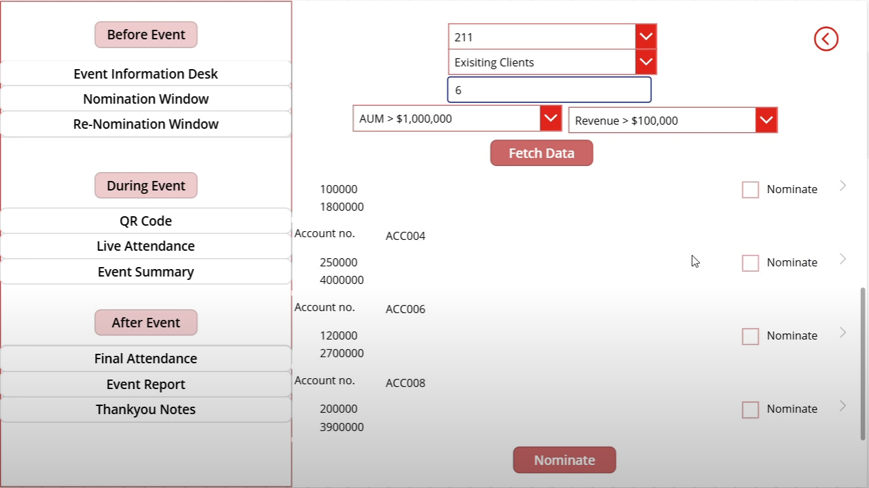
(3.b) Nominations Window
Nomination Window:
In this section, the banker begins by selecting a unique Event ID. Based on this selection, the corresponding event parameters—such as AUM range, Revenue threshold, and Client Type (Existing or Prospect)—are filled. The banker then specifies the number of clients to retrieve (e.g., 20 or 30). Client data is dynamically fetched from the Azure SQL Server and displayed in a gallery format. From this shortlist, bankers can nominate the most suitable clients for the event. All nominations are securely stored in the Nominations table within the database and also pushed to manager’s dashboard for approval.

Slide 9
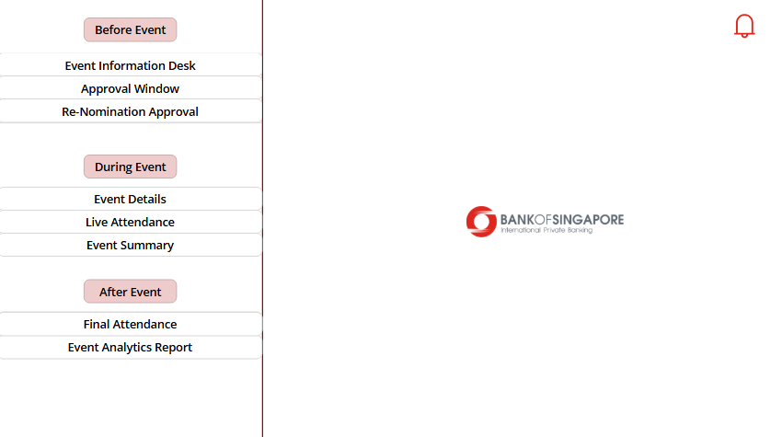
4. Manager’s Screen
Manager Dashboard:
The Manager Dashboard serves as the final approval layer for all client nominations—whether during initial nomination or re-nomination due to declined invitations. Managers also have access to comprehensive post-event analytics and feedback reports shared by the Event Management team. This includes insights on attendance, client feedback, budget vs. actual spend, and performance against predefined selection criteria, enabling a holistic review of each event.

Slide 10
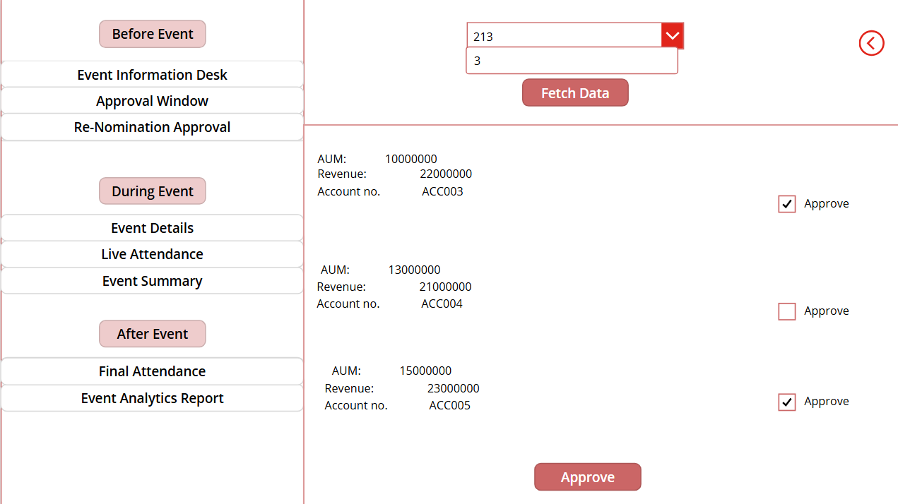
4.(a) Approval Window
Approval Window:
All clients nominated by bankers appear in the Manager’s Approval Window. Here, managers review each nomination along with relevant selection parameters and submission details. Based on this review, they approve or reject clients. Approved nominations are stored in the Approved Clients table in the database, serving as the final confirmation. Once approved, bankers are notified through Evanza’s built-in notification system and can then automatically send event invites to the approved clients.

Slide 11
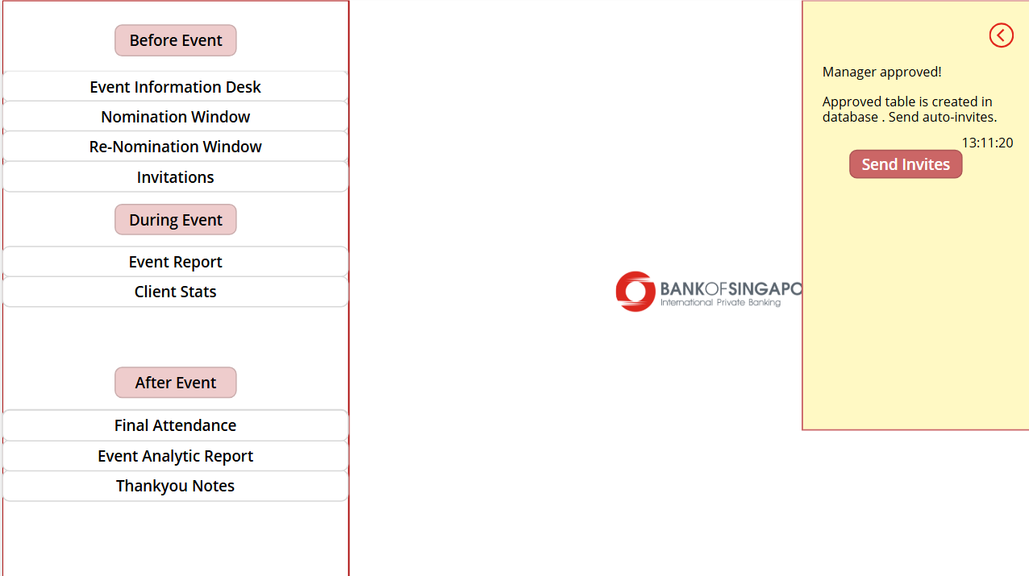
(3.c) Notification And Auto-Invite (Banker’s Screen)
Notifications & Auto-Invites:
The Banker Dashboard features a real-time notification system that alerts bankers as soon as their client nominations are reviewed and approved by the Manager. Upon receiving the notification, bankers can seamlessly initiate automated event invitations for the approved clients. By clicking the "Send Invites" button, they are redirected to the Invitations window to review and finalize the invitations.

Slide 12
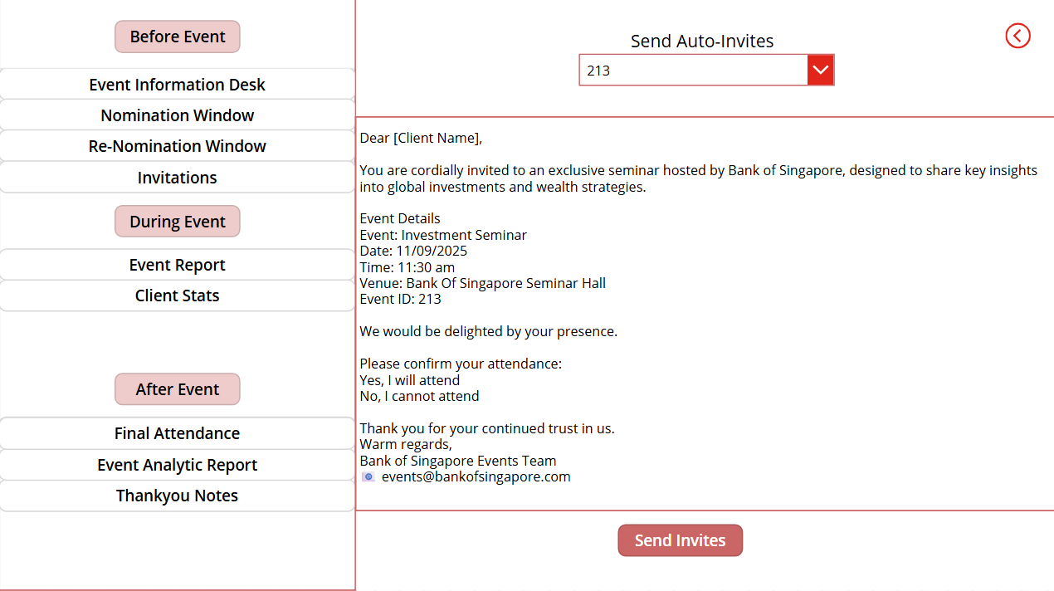
(3.c) Invitations Window (Banker’s Screen)
Invitation & RSVP Workflow All invitations are automatically sent to clients listed in the Approved Clients table, with their names dynamically populated during the process. Each client receives a personalized email containing RSVP options: “Yes, I will attend” and “No, I cannot attend.”
Based on their selection, clients who confirm attendance are recorded in the Confirmed Clients database, while those who decline are stored in the Rejected Clients database.

Slide 13
Re-Nomination And Re-Approval
1. Bankers select the Event ID from the dropdown in the Renomination section, just as done in the initial nomination phase.
2.A refined list of top clients is fetched from the Existing Clients database, excluding those who previously declined the invitation.
3.Bankers review this list and nominate new clients. These entries are stored in the Renomination Table.
4.Managers review and approve the renominations using the same approval framework as the original nominations.
5.Once approved, real-time notifications are triggered to inform bankers of the updated, reapproved list.
6.Bankers can then send automated invitations to the reapproved clients — following the same streamlined, system-driven logic already established in earlier nomination rounds.

Slide 14
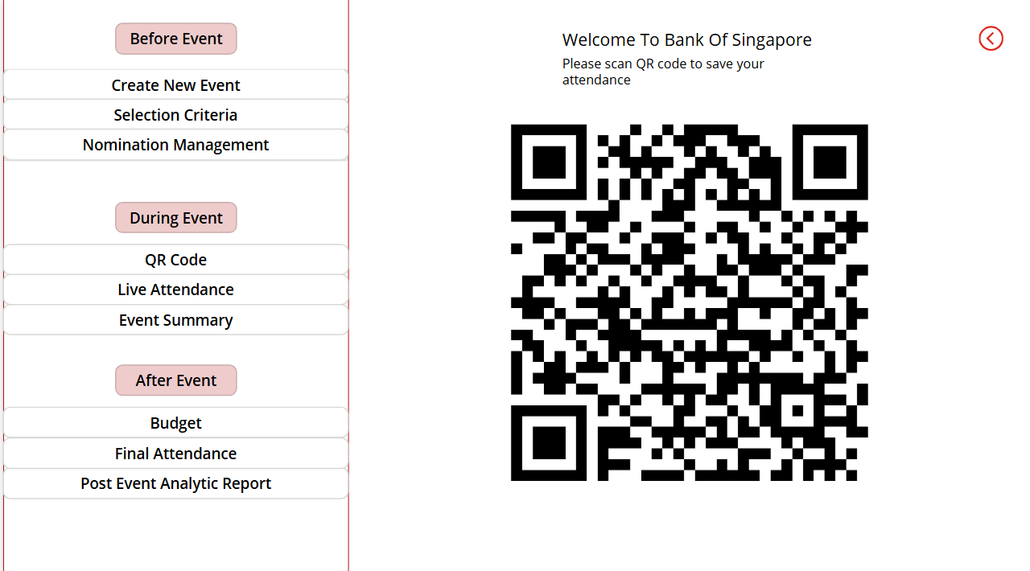
During The Event (QR Code Attendance)
QR Code–Based Attendance
During the event, the Event Manager generates a unique QR code linked to the event’s attendance form. Clients simply scan the QR code upon arrival, enter their phone number, and mark their attendance. The data is securely captured using Microsoft Forms, aligning with our commitment to using Microsoft’s trusted platform for enhanced security and reliability — critical for banking environments. This approach enables a seamless, contactless check-in experience, ensuring that only authorized clients can mark attendance while maintaining accurate and tamper-proof records in real time.
Please Scan The Qr Code For Demo

Slide 15
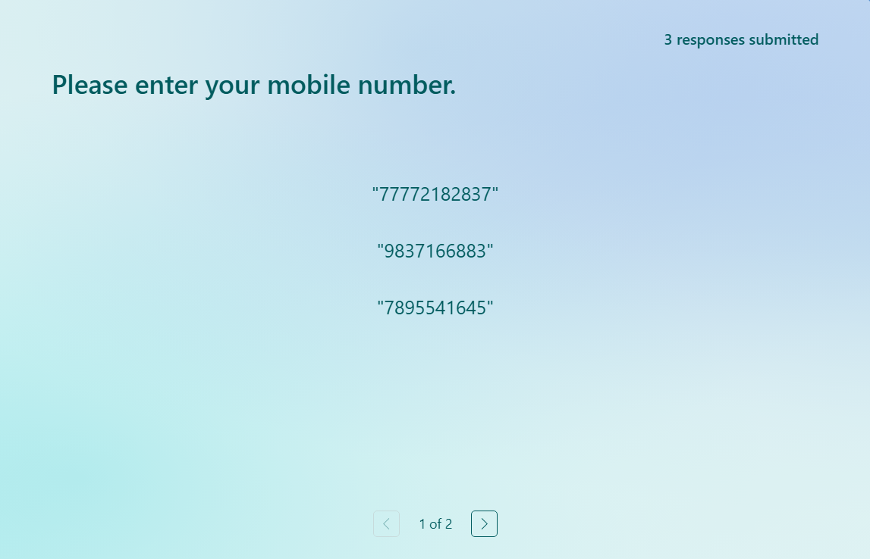
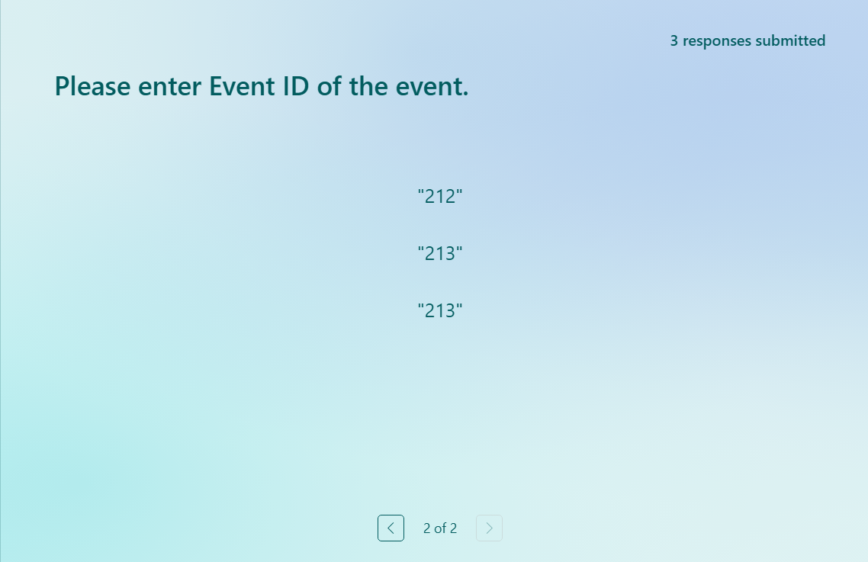
During The Event (QR Code Attendance)
All attendance responses are dynamically and securely stored in the database along with their corresponding Event IDs, as shown in the screenshot. This data can later be reviewed and presented in meetings to showcase actual event attendance—eliminating the need for manual tracking that was previously done.

Slide 16
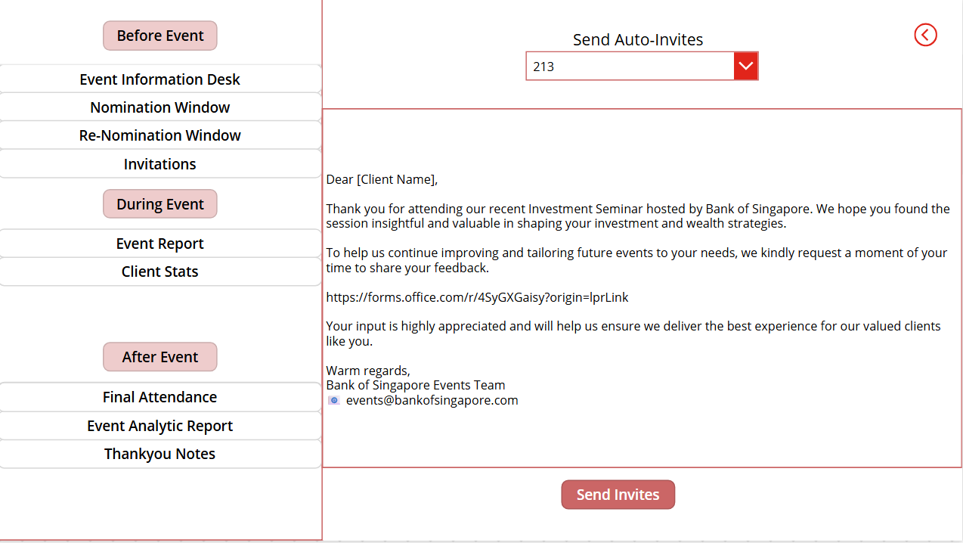
Post Event (Thank You notes and Feedback Form)
Post-Event: Thank You & Feedback Collection
After the event, a personalized thank-you note along with a feedback form is automatically sent to all attendees. This feedback is essential to understand whether the event met client expectations and whether the resources and budget invested were effectively utilized. Clients can share their experience, highlight what they found valuable, and suggest improvements or ideas for future events. This helps the team continuously refine and elevate event quality based on real insights.
Please click on demo link for feedback form.

Slide 17
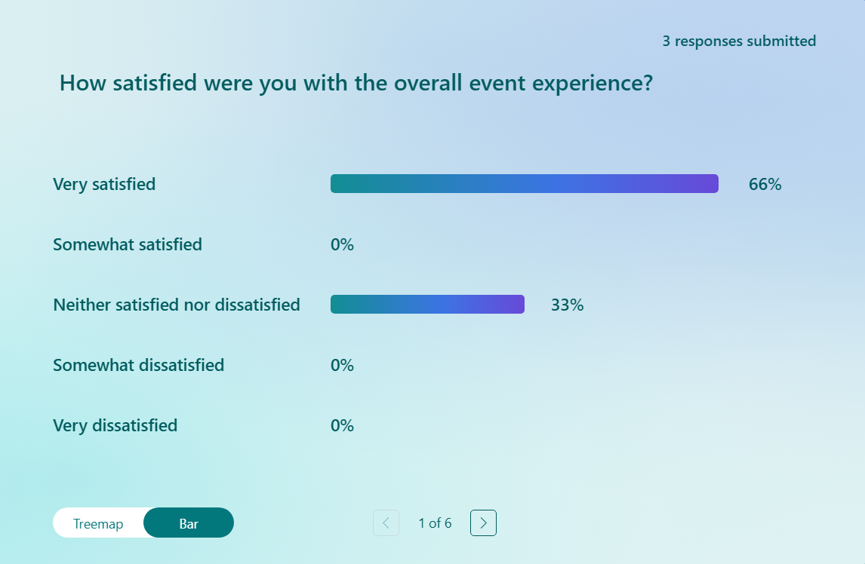
Post-Event Analytics (Event- Manager)
With the help of Microsoft Forms, we can easily track attendance and analyze client feedback in real time. For example, as shown in the screenshot, 66% of users marked "Very Satisfied" while 33% selected "Neutral" for one of the questions. This kind of response breakdown is available for every feedback question, making it highly useful for post-event analysis. The collected data can be shared in meetings with managers and senior stakeholders to assess overall client satisfaction and evaluate the event’s effectiveness. This ensures data-driven decisions for future event planning.

Slide 18
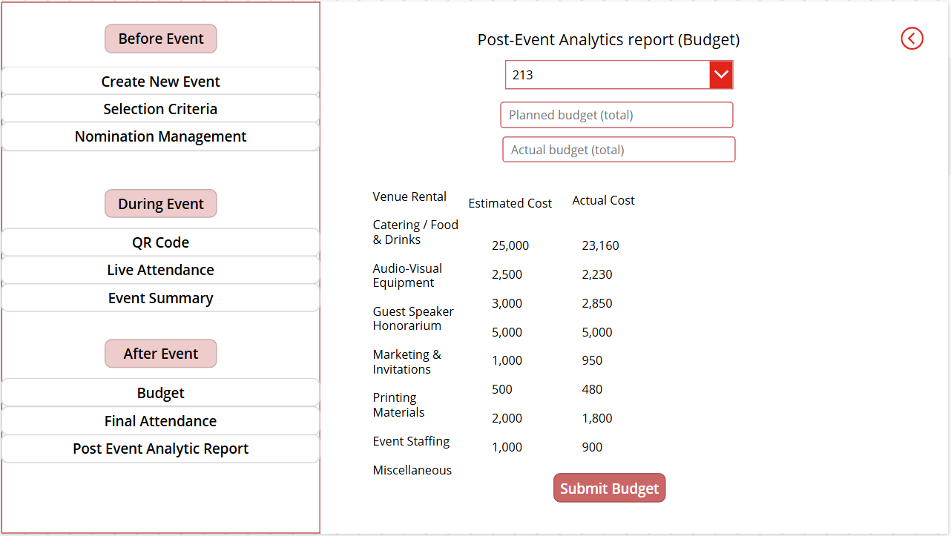
Post-Event Analytics (Event- Manager) Budget
This Post-Event Analytics screen provides a clear comparison between the estimated and actual event costs across key budget categories. From venue rental and catering to staffing and printing, each cost component is transparently tracked to ensure accountability and help evaluate how closely the event adhered to the planned budget. This not only enhances financial oversight but also supports better planning for future events.

Slide 19
Conclusion
1.End-to-End Event Lifecycle: Evanza efficiently manages the entire event journey—before, during, and after—through dedicated modules for event creation, client selection, nomination, and attendance.
2. Smart Data-Driven Workflows: From automated invitations to real-time attendance via QR codes and detailed post-event analytics, all data flows are integrated and securely handled.
3. Client-Centric Experience: Personalized communication, secure check-ins, and structured feedback collection ensure a seamless and professional experience for high-value clients.
4.Bank-Grade Security & Platform Integration: Built entirely using the Microsoft ecosystem (Power Apps, Azure SQL, Microsoft Forms), Evanza ensures data protection, reliability, and scalability—ideal for banking environments.
5. Impactful Reporting for Decision Making: Budget vs. actual analysis, feedback stats, and nomination dashboards offer actionable insights for leadership and future planning.

